Slide 1

GDV4000 Introduction to Games Industry Practice Game Genres: Considerations for Multi-Player Games
BSc Hons Computer Games Design and Development

Slide 2
Based on original research by Dr Paul Angel.
Notes based on:
‘Level Up! The Guide to Great Video Game Design 3rd Edition’. Scott Rogers
‘Multiplayer Game Programming’. Joshua Glazer and Sanjay Madhav

Slide 3
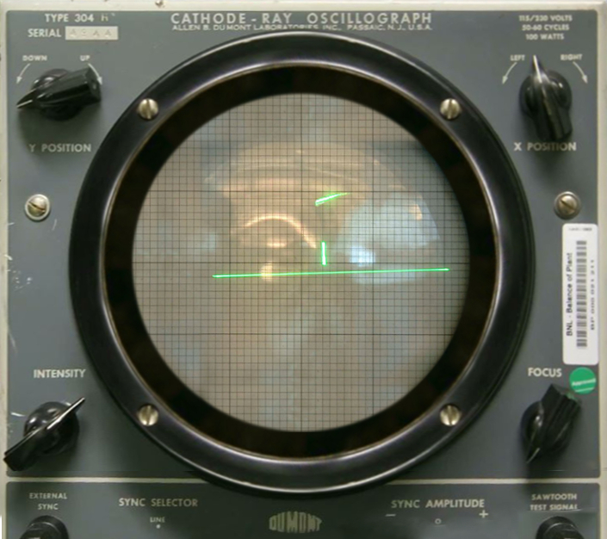
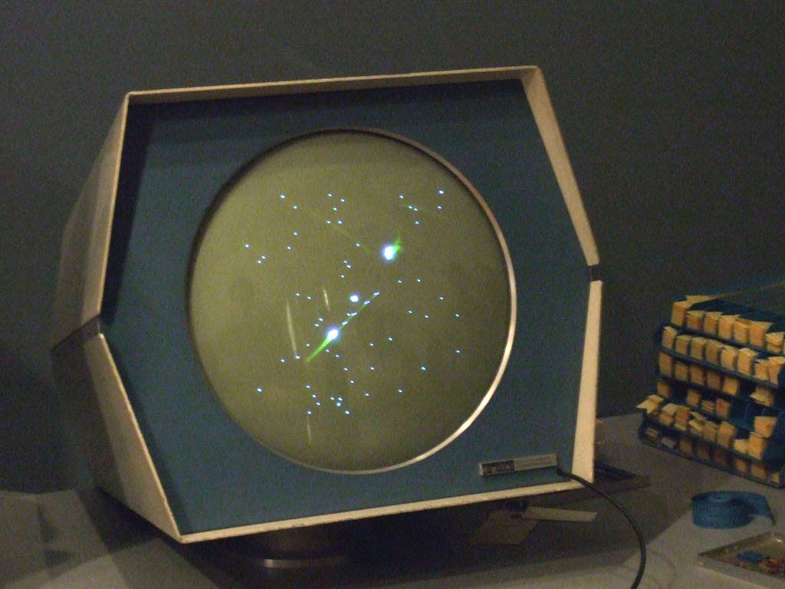
Multiplayer Games: A Brief History
Tennis For Two (1958) and SpaceWar! (1962) were early examples of a multiplayer game, more specifically local multiplayer.
Local multiplayer features two or more players playing the game on a single computer. From a programming perspective, local multiplayer is very similar to single player with the main differences being multiple viewpoints and multiple input devices.
It was not uncommon for local multiplayer games on 8-bit home computers to be played by two people on opposite ends of the same keyboard. Joystick ownership was not assumed!
Tennis for Two © William Higinbotham/Brookhaven National Laboratory
Space War! © Steve Russell

Slide 4
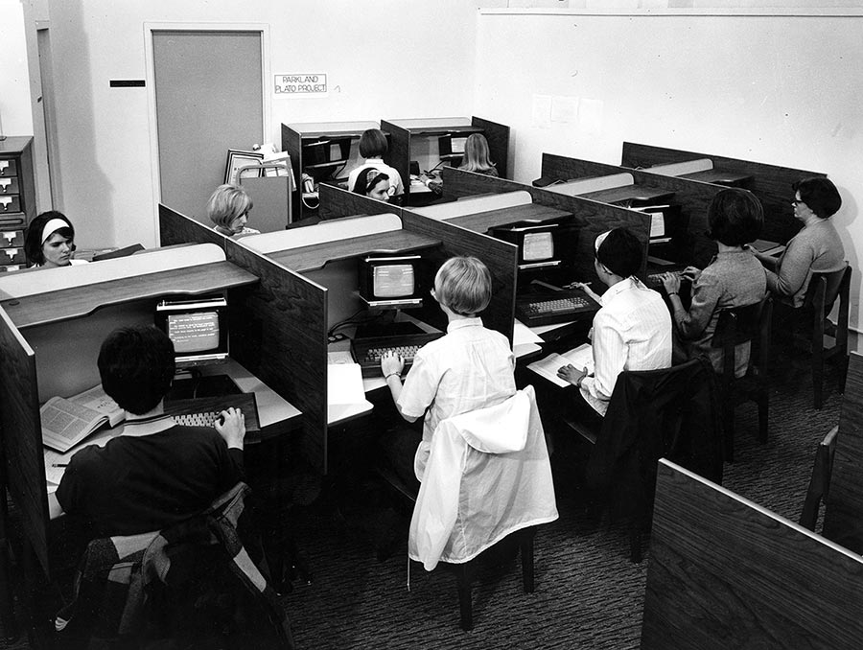
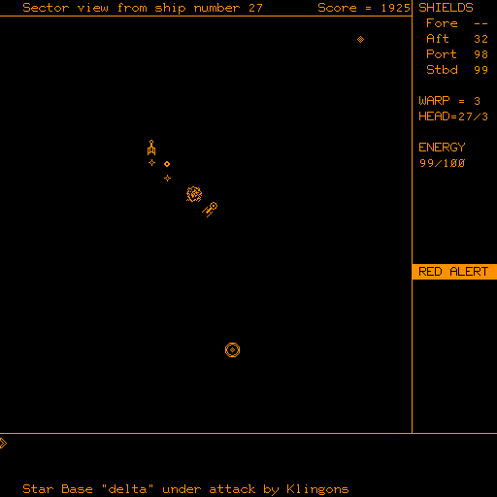
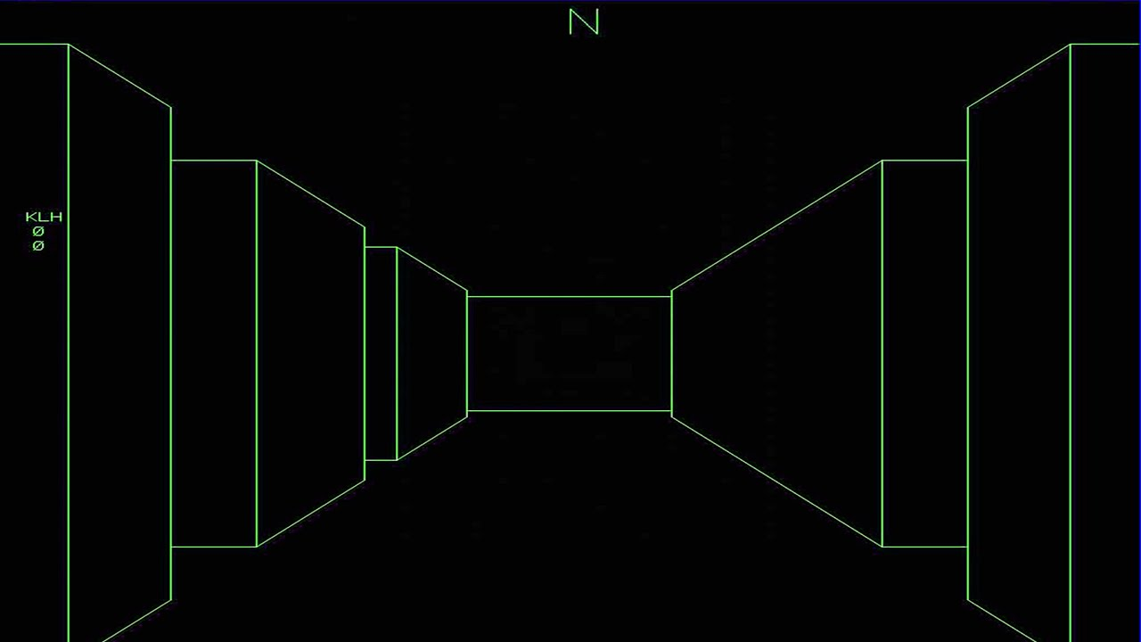
Multiplayer Games: A Brief History
Networked multiplayer games ran on small networks of mainframe computers. Unlike local multiplayer games, these would be two or more computers linked during an active gaming session.
The PLATO system at the University of Illinois was home to the first examples of multiplayer games running on a mainframe network: Empire (1973), and Maze (also known as ‘Maze War’, 1973).
Towards the end of the 1970s, personal computers started to be used more to play multiplayer games via the serial port, which had been more typically used to communicate with external devices such as printers or modems.
PLATO © Illinois Distributed Museum
Empire © John Daleske
Maze © Steve Colley, Greg Thompson, Howard Palmer

Slide 5
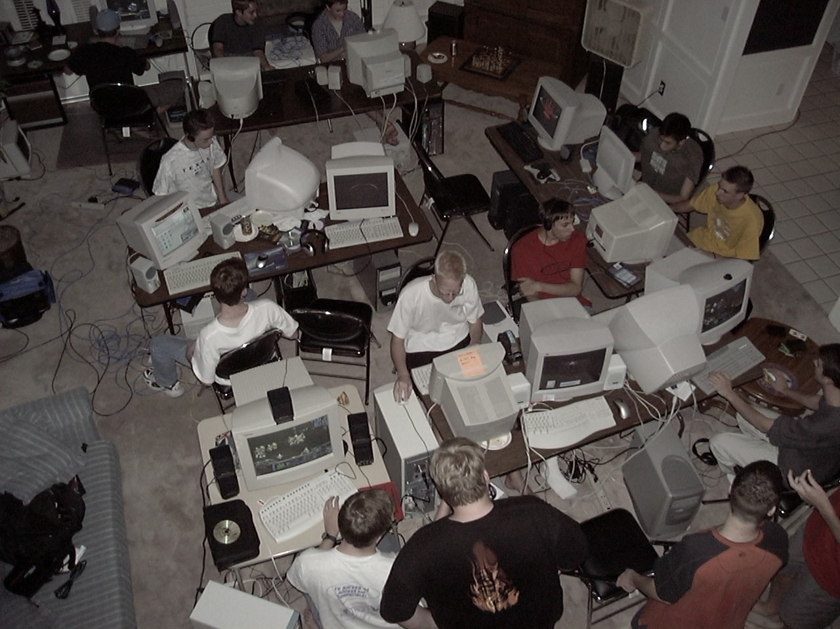
Multiplayer Games: A Brief History
As PCs generally only had two serial ports as standard (more could be added via an expansion card), to play a game with multiple computers would require them to be daisy-chained in a ring. This was one example of a Local Area Network (LAN)
The 1990s saw the rise of LAN parties with ethernet connections taking over from serial port. A LAN party would involve gamers gathering in one location with their computers and connecting them to the network to play together on the same game.
Despite not being the first game to support LAN, the popularity of Doom (1993) lead to the birth of the modern networked game.
LAN Party © Jeremy Jackson

Slide 6
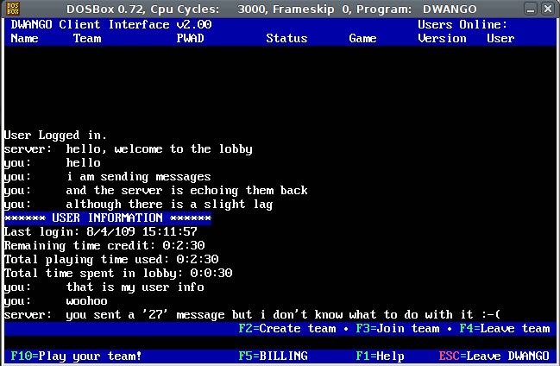
Multiplayer Games: A Brief History
Online games would allow gamers to connect to each other over a much larger distance. Early online games did not necessarily need an internet connection and could connect through network services such as CompuServe.
Online games became popular in the late 1990s as the internet became more widely adopted, with Quake by id Software (1996) and Unreal by Epic Games (1998) being two early examples.
Latency was an issue, with some early games being designed to run on a network rather than the internet. Sony and Microsoft helped facilitate a shift on consoles with the creation of the PlayStation network and Xbox Live, which were based on the same principles as the earlier PC-based services such as GameSpy and DWANGO (Dial-up Wide Area Network Game Operation).
LAN Party © Jeremy Jackson
DWANGO © Interactive Visual Systems

Slide 7
Multiplayer Games: Sub-Genres
Split-Screen
Shared-Screen
Multiplayer games started as an extension of single player games, where instead of facing challenges presented by AI controlled NPCs, the game engaged multiple players against each other.
Multiplayer games can be divided into different groups, but from an architectural perspective they can be factored into the following groups…
From a mechanics point of view, multiplayer games share many elements of single-player games (particularly player interaction).
Gameplay, flow, and level design can differ greatly from the single-player experience.
Non-Networked
Multiplayer Game
Networked
LAN
Peer-to-Peer
Client-Server

Slide 8
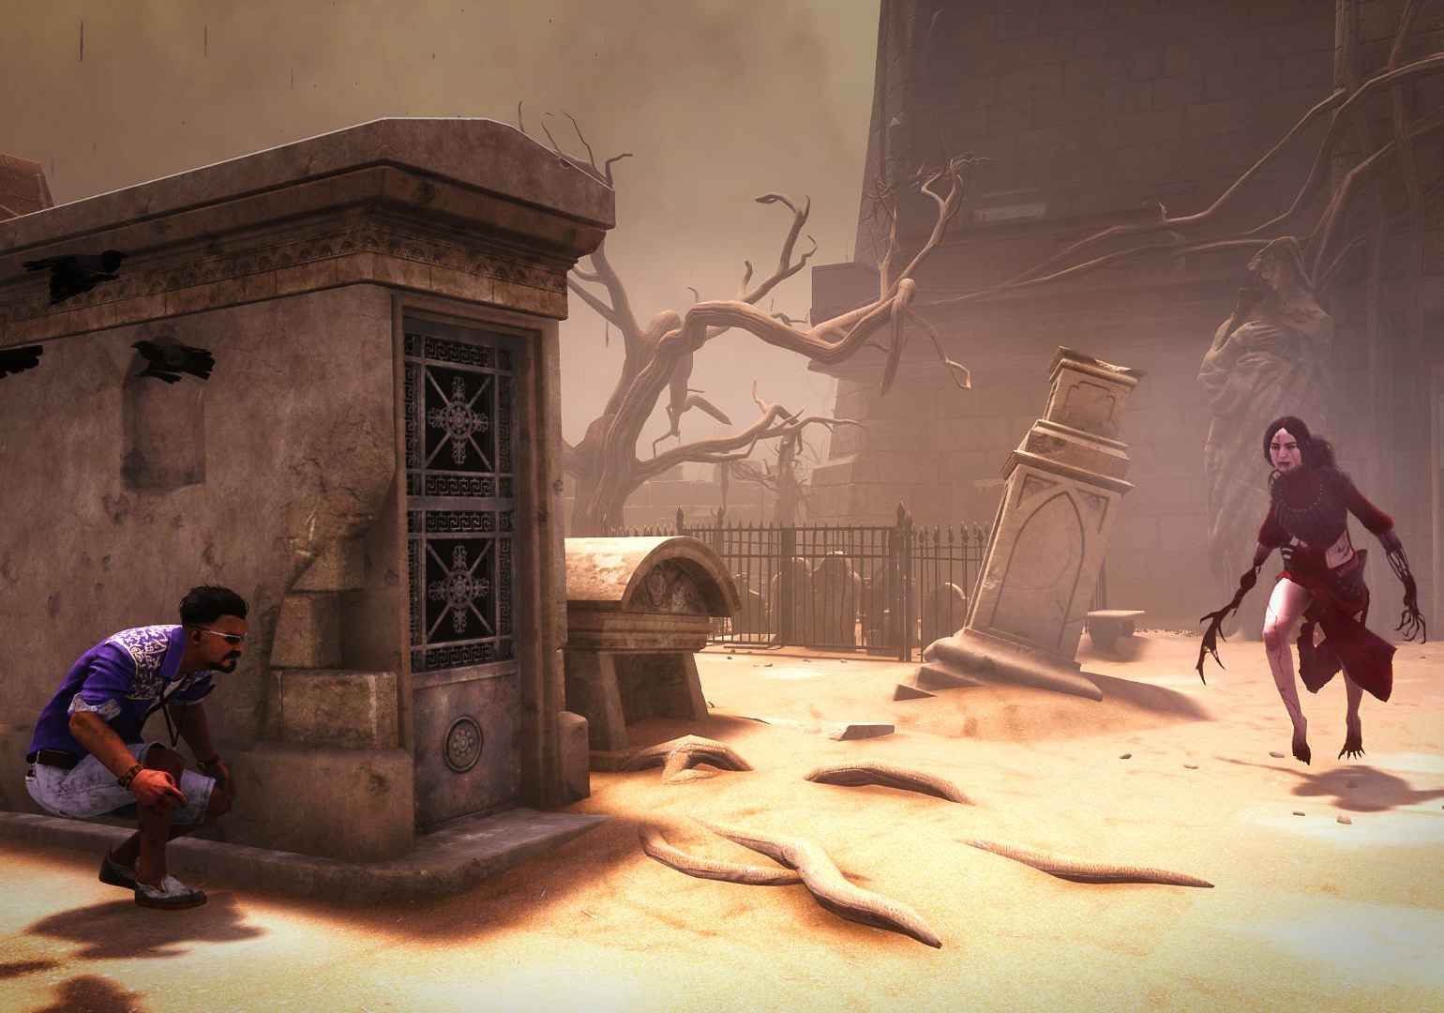
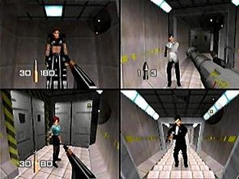
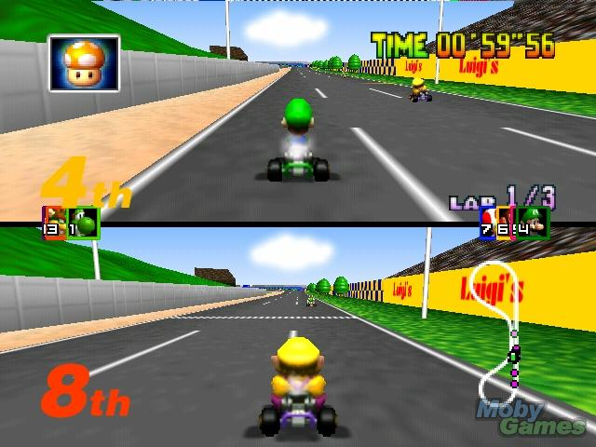
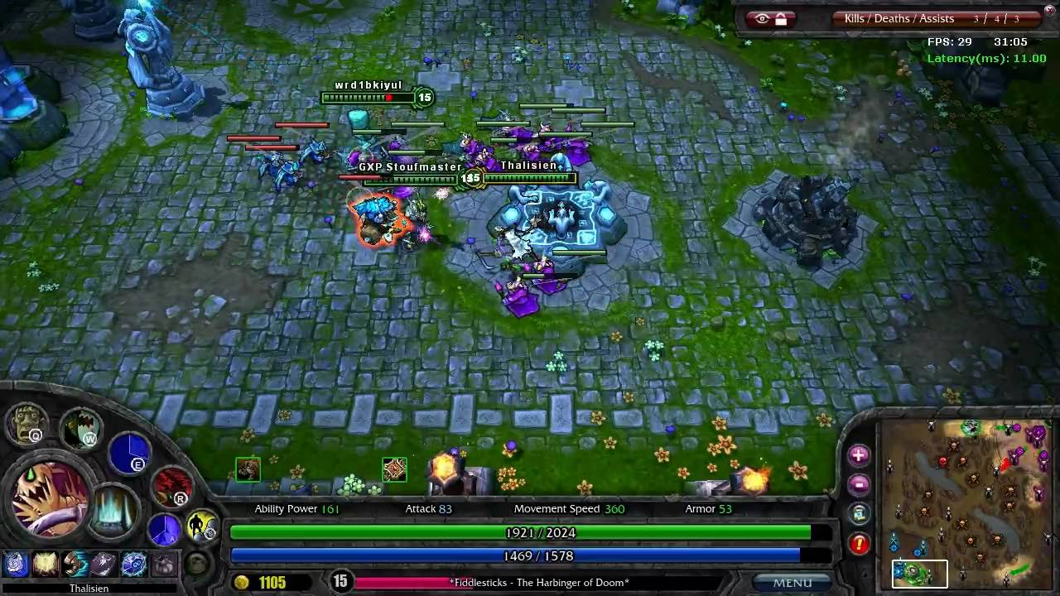
Dead by Daylight © Behaviour Interactive
Multiplayer Games: Sub-Genres
Within multiplayer games there are numerous modes of play:
Competitive
Multiple players compete to acquire (limited) resources and complete a task – This could be reaching a high score or a set number of kills against a time limit.
GoldenEye © Rare
Cooperative
Players work together to achieve a particular goal. This could involve progression through a set of levels or might involve players teaming up to defeat other teams within an arena environment.
There are combinations of the two – Team Deathmatches require both cooperation and competition.
Conjugate
Gamers share the same gameplay space but may be involved in their own missions/quests/goals. This can be seen in FPSs, MMOs, and MMORPGs.
Mario Kart 64 © Nintendo
League of Legends © Riot Games

Slide 9
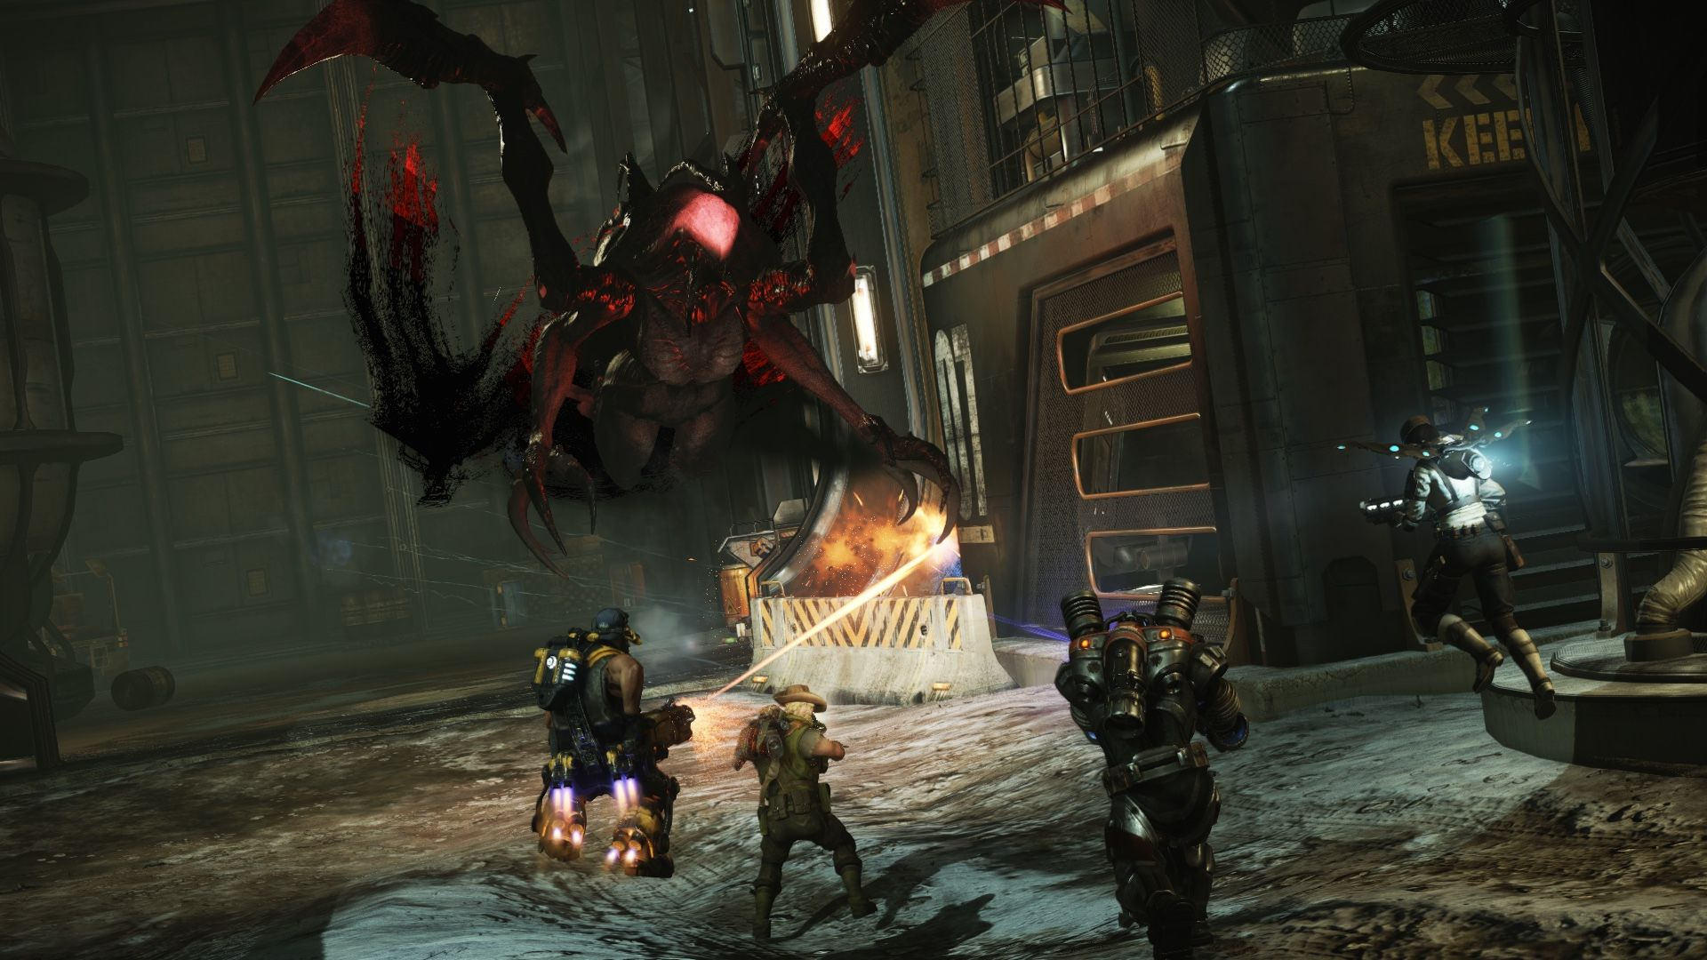
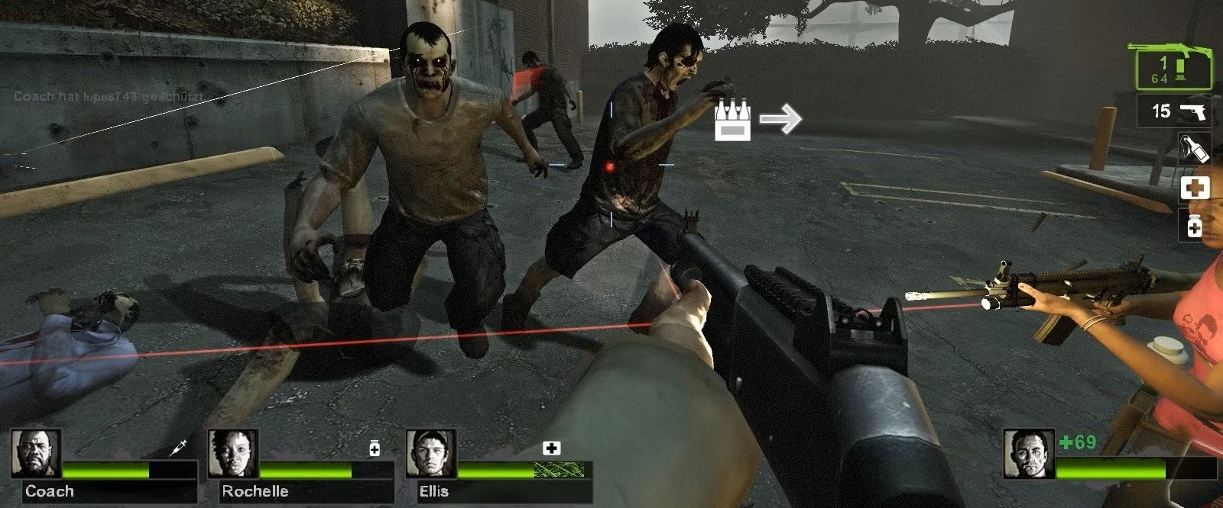
Multiplayer Games: Sub-Genres
Symmetric / Asymmetric Multiplayer
Symmetric
Players have the same basic abilities, which makes the experience similar for each player
Asymmetric
Players have different abilities which contribute to the overall team. Gameplay characteristics are designed for each player. The game designers need to provide a suitable balance between the player being able to defend and attack, but also perform their task as needed.
Evolve © Turtle Rock Studios
Left 4 Dead 2 © Valve

Slide 10
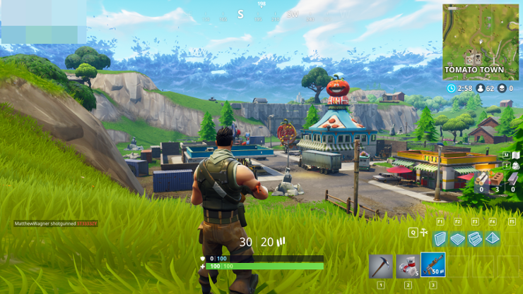
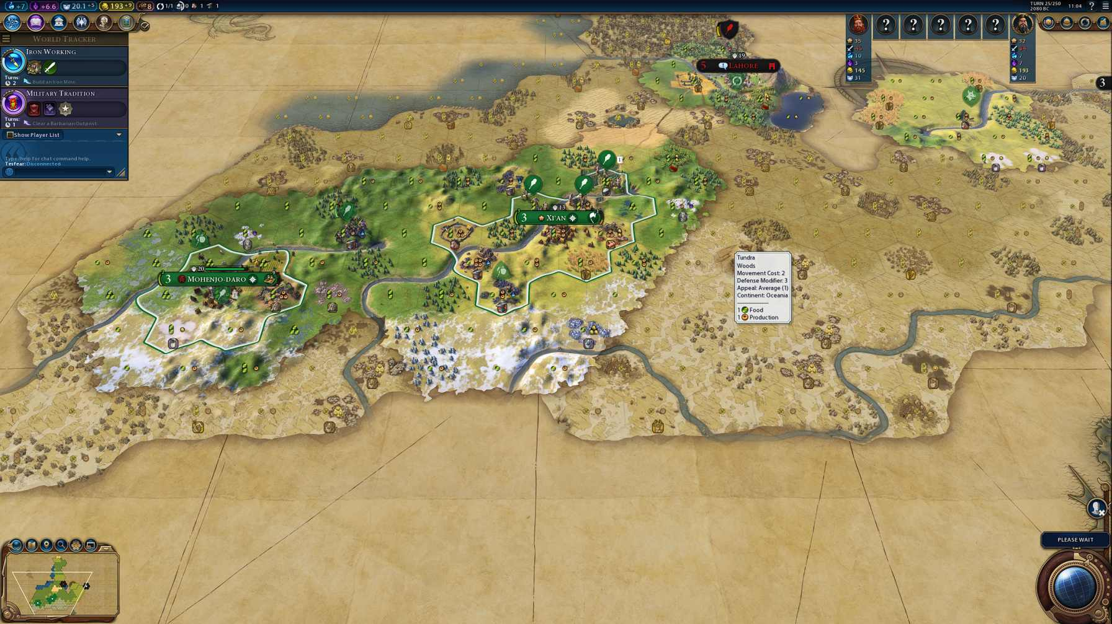
Multiplayer Games: Sub-Genres
Synchronous / Asynchronous Multiplayer
Synchronous
Players must be online and competing in real time.
Asynchronous
Players are not required to be online at the same time and are notified when it is their turn. They generally do not have any time restrictions over how long they have to take their turn.
Fortnite © Epic Games
Sid Meier’s Civilisation VI © Firaxis Games

Slide 11
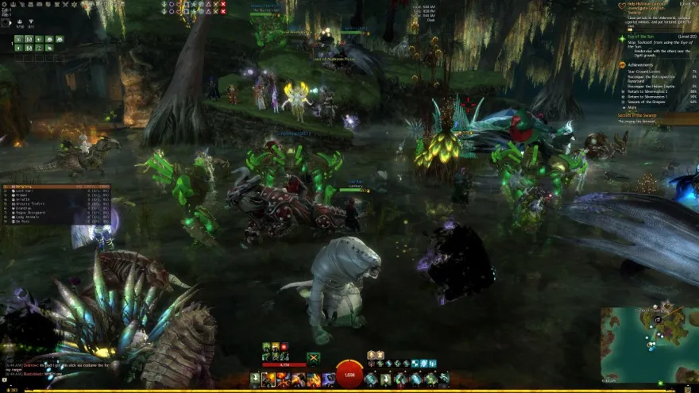
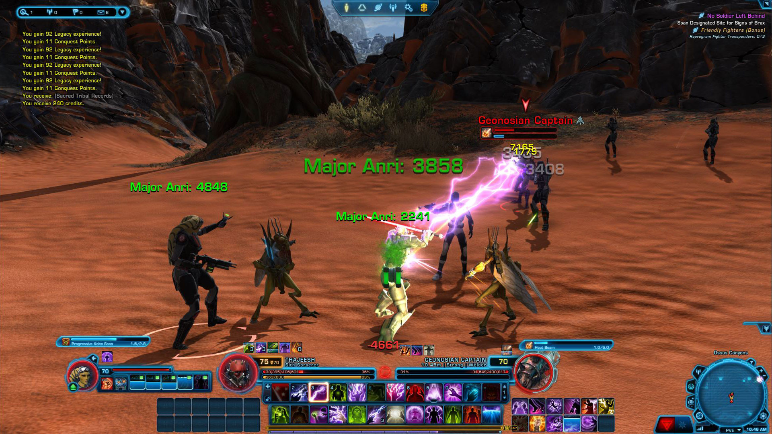
Multiplayer Games: Sub-Genres
The multiplayer model has evolved and grown into different game genres, and numerous sub-genres have emerged:
MUDs
Multi-User Dungeons (MUDs) were an early form of multiplayer RPG. Players interacted with each other and NPCs , with elements being incorporated from adventure and RPG games. Gameplay typically involved the player receiving descriptions of the locations/rooms, who else was present (other players, NPCs), what objects were in the environment, and where the exits were. The player interacted via natural language text-based commands such as “pick up axe”, “head north”.
MMORPG
Massively Multiplayer Online Role-Playing Games belong to the asymmetric genre, where players inhabit a large virtual world as a particular character/ character type. This type of RPG is distinguished by the sheer volume of players that interact, as well as the persistent world which is typically maintained on the publisher’s servers.
Guild Wars 2 © ArenaNet
Star Wars: The Old Republic © Bioware/EA

Slide 12
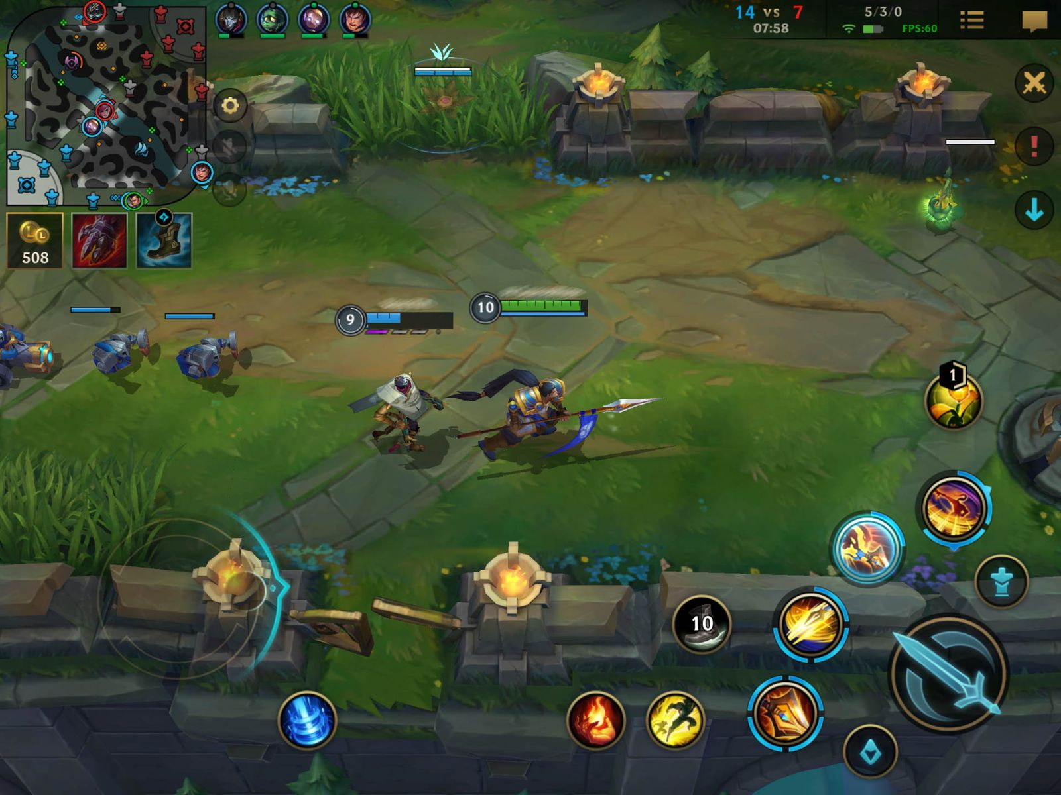
Multiplayer Games: Sub-Genres
MOBA (ARTS)
Multiplayer Online Battle Arena games emerged as a sub-genre of the Real-Time Strategy genre (Action Real-Time Strategy). Gameplay typically consists of two or more teams of around 4 players who move/ control units along set paths to attack the opposing team.
Knowledge
These can be played remotely or with people being in the same room. Many popular TV quiz shows have been realised as video games, such as Who Wants to be a Millionaire, The Price is Right. Games, such as the ones made by Jackbox Games can be played with a mobile phone as the input, with the game running on a PC or Console.
League of Legends © Riot Games
Creation
Games such as Roblox, Minecraft, No Man’s Sky and Spore have multiplayer components where other players can visit and interact with other players’ creations. GTA Online and Hitman: World of Assassination feature challenges, missions, and modes based on community created content. This can be a very shrewd and rewarding way of building a community around the game and extending shelf life.

Slide 13
Level Design Considerations
With multiplayer design, there are several factors that need to be considered that would not necessarily be as important when designing a single player experience.
Numbers – How dependent on multiplayer is your game? This can be a good place to start, as the answer to this question could impact many design choices early on. Fighting games can vary from 2-4 players, MMOs like World of Warcraft can run 4000 – 5000 players per server.
Communication: How are your players going to communicate. Many MMOs use an in-game text chat or use an external application such as Discord. Phasmophobia uses an in-game radio, which ties into the game mechanics. The ghost might be listening to you!
Terrain: Important for both single and multi-player games, but when designing for multiplayer, consideration must be given for creating positions that offer both cover and also positions to attack the opposition from.
Multiple paths: Give the player multiple ways in and out of each region of the map – provide a means of exploration and a means of escape.

Slide 14
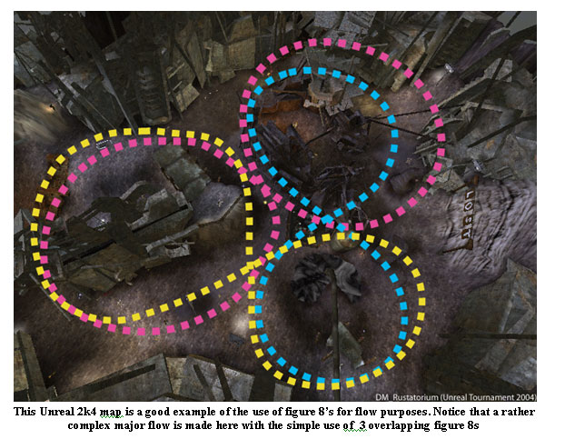
Level Design Considerations
Level Flow: Important to consider how players progress through levels in a multiplayer game. Typically, a designer will identify key areas and then consider the connections between those areas. Several patterns/structures can be adopted:
Circle - Less interesting but can be useful as a starting point to branch addition regions/paths from.
Figure-8 – A common pattern that provides a good flow through the level as well as intersecting points where challenges and ambushes can occur.
http://www.ongamedesign.net/designing-fps-multiplayer-maps-part-1/
Focal Points: It can be good practice to include a focal point on each level (which may be thematically linked to the level). This can provide both a point of interest and a visual reference for navigating the level. Focal points will be a key structure if modelling a city, or a terrain feature in open spaces. Very important to include this when designing for ‘King of the Hill’.
Verticality: Adding multiple levels/heights (walkways, overhangs) allows for more varied gameplay within the confines of the level and gives the players more choices.

Slide 15
Level Design Considerations
Mapping the Level
Keep it Simple: The circle, figure-8 and other simple shapes will stop your player getting lost and disoriented. It also makes the job of the designer easier when implementing objectives. Your multiplayer map design will be very different to a single player map.
Mirror: Copy and flip your map design! It saves on production time and gives your players a good idea of how to navigate the enemy base before they get there.

Slide 16
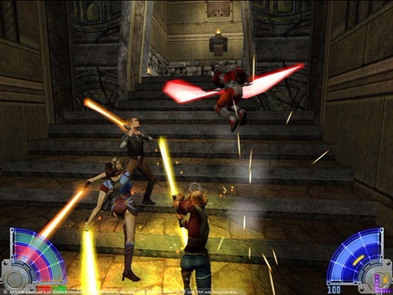
Level Design Considerations
Mapping the Level
Walls: Create walls to funnel the players – bridges and tunnels can be useful for creating stand-off situations.
Defensible areas: Allow players some time to get to know the environment and plan before the fight begins. This can be done through ‘Hold the platform’ type events. GTA Online Survival Modes do this by having a cooldown period to quickly restock and take cover before the enemies start to arrive.
Star Wars Jedi Knight: Jedi Outcast © LucasArts

Slide 17
Level Design Considerations
No Man’s Land: An area of great risk and reward – make sure to plan open spaces otherwise taking cover loses its impact. Try to push the players into breaking cover. As stated previously, alternate routes may be designed to bypass the open areas, but the other players may also use these and take the fight to a different area.
Spawn Points: These need to be a balance between seeing the player coming but not so that it provides an unfair advantage (“spawn camping”). Spawning into open areas which are unsafe to linger in or provide a shielded space for players to spawn behind.
Provide alternate routes: Tunnels, zip-lines, swim through water… there are many ways to get around the map. Allowing players to use these can aid their enjoyment of the map and the different approach strategies they can employ.

Slide 18
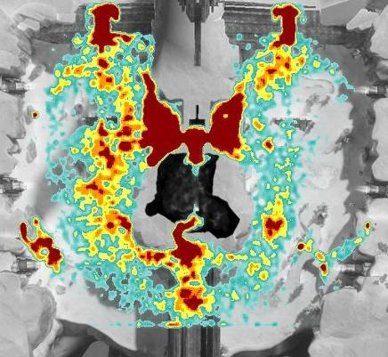
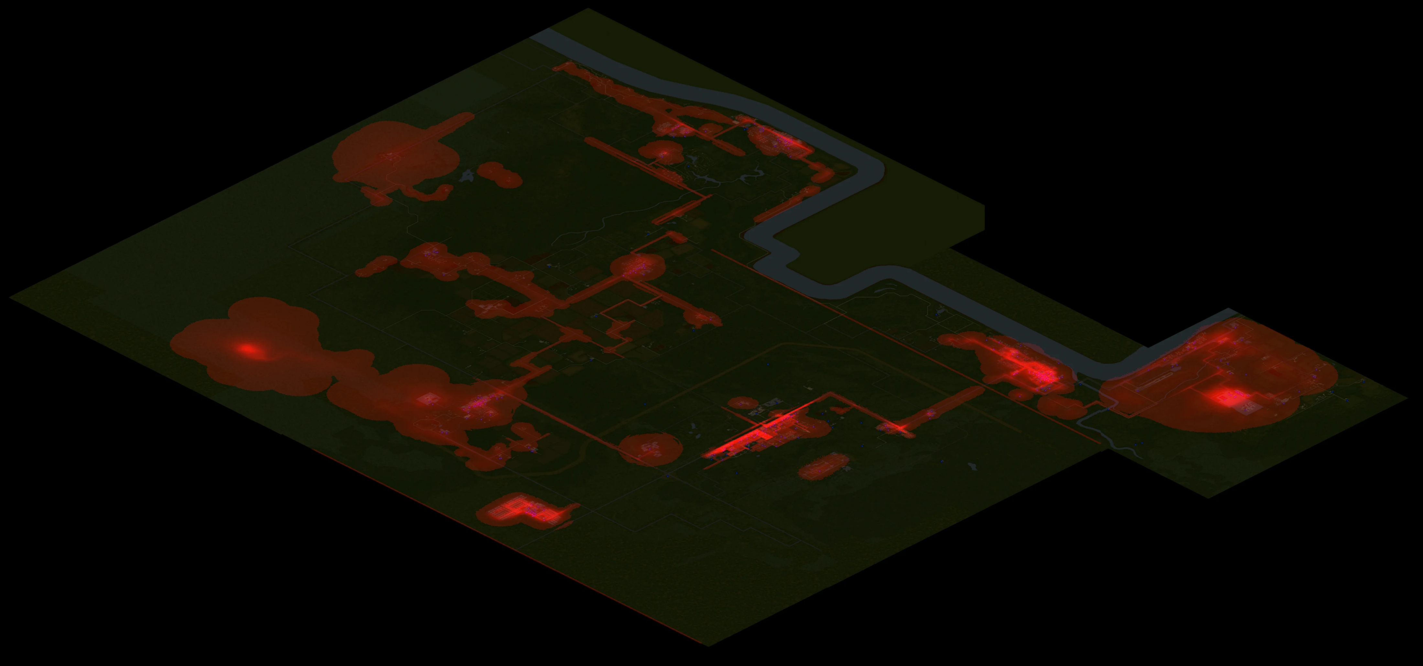
Level Design Considerations
Building the Level
Collisions: Grey boxing your level can be a good way to check for areas where the player can get caught or snagged on collision. Stairs, ledges and corners can be problematic. Be mindful of seams between collision where the player could fall through.
Play testing: Important regardless of the genre, but it is very useful for multiplayer maps to see how they are used. Heatmaps (code that tracks what players are doing) can be used to show where players go, where fights happen, places they take cover or hide. This data can be used to modify the map – the goal is to create a space where players use as much of the space as possible, not camp out in certain places.
Heatmap from Halo 3 © Bungie
Heatmap showing zombie spawn locations in Project Zomboid © The Indie Stone

Slide 19
Level Design Considerations
Textures: Ensure that the textures on the floor and walls are easy to differentiate to highlight the pathway quickly and easily. Keep colours light and uncluttered where possible. Lighting can also be used to aid navigation.
Sound: Pay attention to your sound design and keep a balance between diegetic, non-diegetic, and sounds that may be made by other players. If it is important to hear where other players are, make sure they can be identified easily.

